Slide 1
Learning

Slide 2
Definition: Learning is…
A change in behavior as a result of experience or practice.
The acquisition of knowledge.
Knowledge or skill gained through study, teaching, instruction or experience.
A process by which behavior is changed, shaped or controlled for a relatively long period of time or permanently.
The individual process of constructing understanding based on experience from a wide range of sources.
Learning is not: changes due to growth or maturation

Slide 3
Some First Principles
Learning is something all humans do
  Fetuses learn
  Infants learn
  Children learn
  Adults learn
Learning is not uniquely human – all living things learn
Learning evolved as an adaptation for promoting survival

Slide 4
What is Learning?
Learning is a process
Learning is a product

Slide 5
Process of Learning
Learning involves the individual
  Brain
  Body
Learning involves others
  Dyads
  Groups
  Organizations
  Communities
  Society
Learning takes place somewhere
  In physical environment
  With things and tools
Learning occurs over time

Slide 6
Products of Learning
Learning is about ideas and concepts
Learning is about behaviors and skills
Learning is about attitudes and values

Slide 7
Definition: Theories are…
What is a theory?
  A theory provides a general explanation for observations made over time.
  A theory explains and predicts behavior.
  A theory can never be established beyond all doubt.
  A theory may be modified.
  Theories seldom have to be thrown out completely if thoroughly tested but sometimes a theory may be widely accepted for a long time and later disproved.

Slide 8
So, how do people learn?
Easy answer: We don’t know for sure.
Difficult answer: We have multiple theories that provide glimpses of an answer from many different perspectives. These stem from psychologists, philosophers, sociologists, anthropologists, evolutionary biologists, linguists, neuroscientists…

Slide 9
Broad domains of theories
Behaviorism
Constructivism
Sociocultural
Cognitivism
I believe that (the) educational process has two sides—one psychological and one sociological. . . Profound differences in theory are never gratuitous or invented. They grow out of conflicting elements in a genuine problem.
-John Dewey, In Dworkin, M. (1959) Dewey on Education

Slide 10
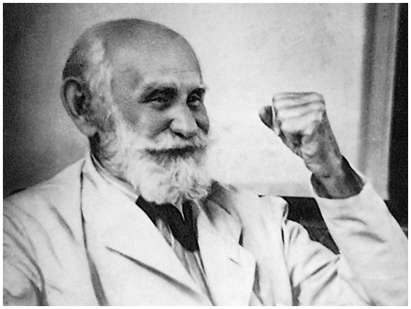
Classical Conditioning
Ivan Pavlov (1849-1936)
  Russian physician/ neurophysiologist
  Nobel Prize in 1904
  Studied digestive secretions
  ‘Classical’ early experiments
  Pavlovian conditioning; respondent conditioning

Slide 11
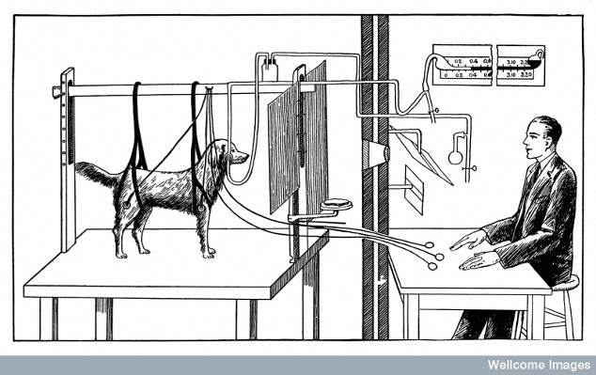
Pavlov’s apparatus for studying the conditioned salivary response

Slide 12
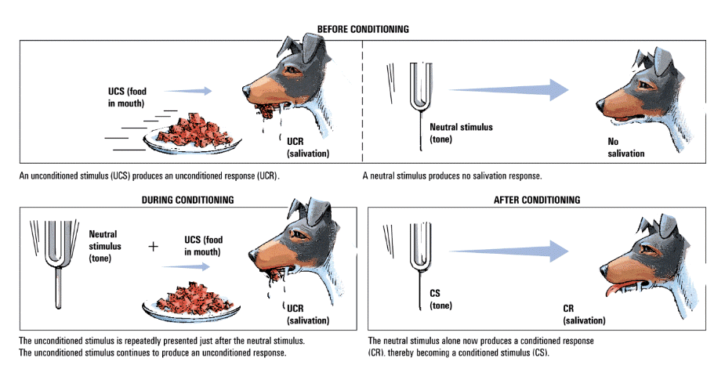
Pavlov’s Classical Experiment

Slide 13
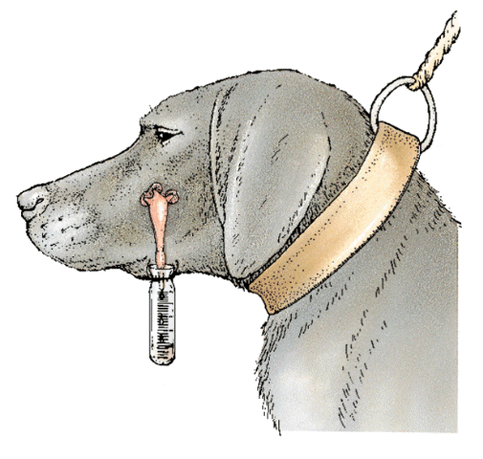
Responses acquired
Stimulus (Latin word for ‘goad’ or ‘prod’: events that evoke: anything in the environment detected by the senses)
Conditioned stimulus: neutral stimulus: alerts without specific response
Unconditioned stimulus: consistently or reliably evokes a response
Unconditioned response: response reliably follows the US
Conditioned response: CS-US pair: the CS evokes CR

Slide 14
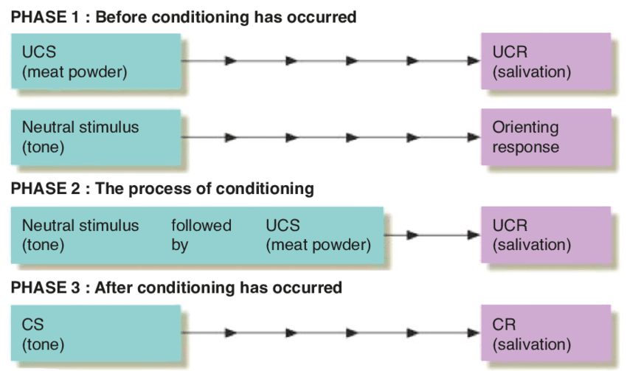

Slide 15
  organism comes to associate two stimuli
  a neutral stimulus that signals an unconditioned stimulus
  begins to produce a response that anticipates and prepares for the unconditioned stimulus
Unconditioned Stimulus (UCS)
  stimulus that unconditionally--automatically and naturally--triggers a response
Unconditioned Response (UCR)
  unlearned, naturally occurring response to the unconditioned stimulus (salivation when food is in the mouth)
Conditioned Stimulus (CS)
  originally irrelevant stimulus that, after association with an unconditioned stimulus, comes to trigger a conditioned response
Conditioned Response (CR)
  learned response to a previously neutral conditioned stimulus

Slide 16
Acquisition
  the initial stage in classical conditioning
  the phase associating a neutral stimulus with an unconditioned stimulus so that the neutral stimulus comes to elicit a conditioned response
  in operant conditioning, the strengthening of a reinforced response

Slide 17
Extinction
  diminishing of a CR
  in classical conditioning, when a UCS does not follow a CS
  in operant conditioning, when a response is no longer reinforced

Slide 18
Acquisition
(CS+UCS)
Strength
of CR
Spontaneous
recovery of
CR
Extinction
(CS alone)
Extinction
(CS alone)
Pause
Course of conditioning (McGeoch & Irion, 1952)

Slide 19
Spontaneous Recovery
  reappearance, after a rest period, of an extinguished CR
Generalization
  tendency for stimuli similar to CS to elicit similar responses
Discrimination
  in classical conditioning, the learned ability to distinguish between a CS and other stimuli that do not signal a UCS

Slide 20
Baby Albert:
https://www.youtube.com/watch?v=FMnhyGozLyE

Slide 21
Theories about Classical Conditioning
Stimulus substitution: CS acquires capacity to substitute for the US in evoking a response: association between CS and US so that CS becomes equivalent to the US in eliciting a response
Two areas of the brain activated: US reflex response
Disadvantage: CR is not equivalent to the UR

Slide 22
Information and expectation: CS is a signal for US
In the presence of CS, US is expected and the learner responds in accord of the expectation
Novelty of US
Memory trace: CS consistently present before the US
Behaviours engaged by the learner in anticipation of a future event (US)

Slide 23
Significance
Event: CS
Role of emotional response in humans: CR
Role in behavior modification and behavior therapy

Slide 24
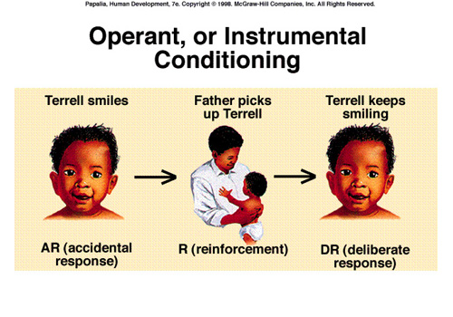
Operant Conditioning
Association of a response with its consequence

Slide 25
Instrumental conditioning: some action (behavior) of the learner is instrumental in bringing about a change in the environment that makes the action more/less likely to occur in the future
Rewards/ punishments/ positive or negative reinforcements
Operant conditioning: Skinner: when a response operates on the environment, the consequences affect the likelihood of its occurance

Slide 26
Law of Effect
Thorndike’s principle: behaviors followed by favorable consequences become more likely, and behaviors followed by unfavorable consequences become less likely
Operant Behavior
  operates (acts) on environment
  produces consequences
Respondent Behavior
  occurs as an automatic response to stimulus
  behavior learned through classical conditioning

Slide 27
Operant Behavior
  operates (acts) on environment
  produces consequences
Respondent Behavior
  occurs as an automatic response to stimulus
  behavior learned through classical conditioning

Slide 28
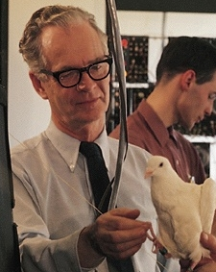
B.F. Skinner (1904-1990)
  elaborated Thorndike’s Law of Effect
  developed behavioral technology

Slide 29
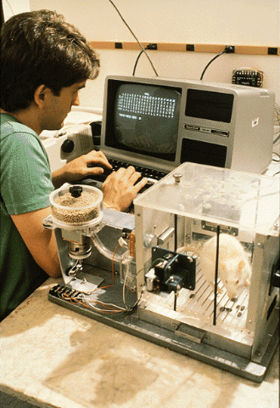
Operant Chamber
Skinner Box
  chamber with a bar or key that an animal manipulates to obtain a food or water reinforcer
  contains devices to record responses

Slide 30
Reinforcer
  any event that strengthens the behavior it follows
  Positive: stimulus/ event which, following a response, increases the likelihood that the response will be made again
  Negative: stimulus/event which, when its termination is contingent on a response, increases the likelihood of the behavior occurring again
Shaping
  operant conditioning procedure in which reinforcers guide behavior toward closer approximations of a desired goal

Slide 31
Primary Reinforcer
  innately reinforcing stimulus
  i.e., satisfies a biological need
Conditioned Reinforcer
  stimulus that gains its reinforcing power through its association with primary reinforcer
  secondary reinforcer

Slide 32
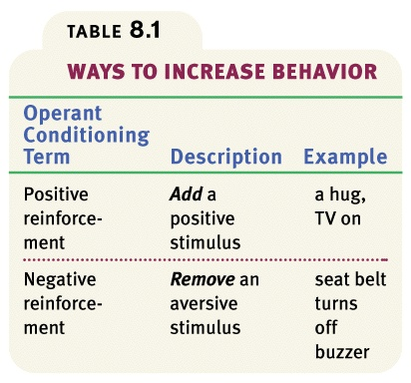

Slide 33
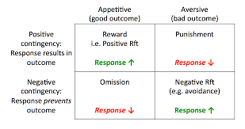
Punisher: stimulus/event which, when its onset is contingent on a response, decreases the likelihood that the response will occur
Omission of reinforcement: Omission training: positive reinforcement is withdrawn following a response to decrease the likelihood of a response that led to the removal of the positive reinforcement

Slide 34
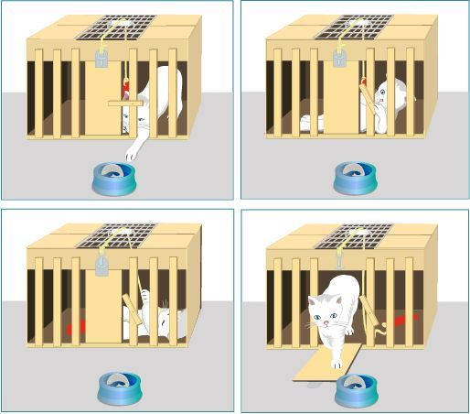
Thorndike’s experiment: Cats in a puzzle box

Slide 35
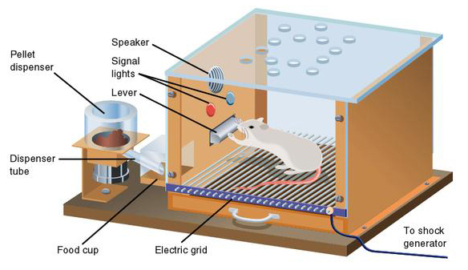
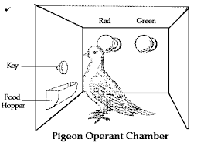
Skinner’s experiments: Rats and pigeons in an operant chamber

Slide 36
Shaping behavior with positive reinforcement
Extinction of positively reinforced response
Conditioned positive reinforcers
Stimulus generalization
Stimulus discrimination
Negative reinforcement and escape learning
Avoidance learning

Slide 37
Schedules of reinforcement
Continuous Reinforcement
  reinforcing the desired response each time it occurs
Partial (Intermitent) Reinforcement
  reinforcing a response only part of the time
  results in slower acquisition
  greater resistance to extinction

Slide 38
Fixed Ratio (FR)
  reinforces a response only after a specified number of responses
  faster you respond the more rewards you get
  different ratios
  very high rate of responding

Slide 39
Variable Ratio (VR)
  reinforces a response after an unpredictable number of responses
  average ratios
  like gambling, fishing
  very hard to extinguish because of unpredictability

Slide 40
Fixed Interval (FI)
  reinforces a response only after a specified time has elapsed
  response occurs more frequently as the anticipated time for reward draws near
Variable Interval (VI)
  reinforces a response at unpredictable time intervals
  produces slow steady responding
  like pop quiz

Slide 41
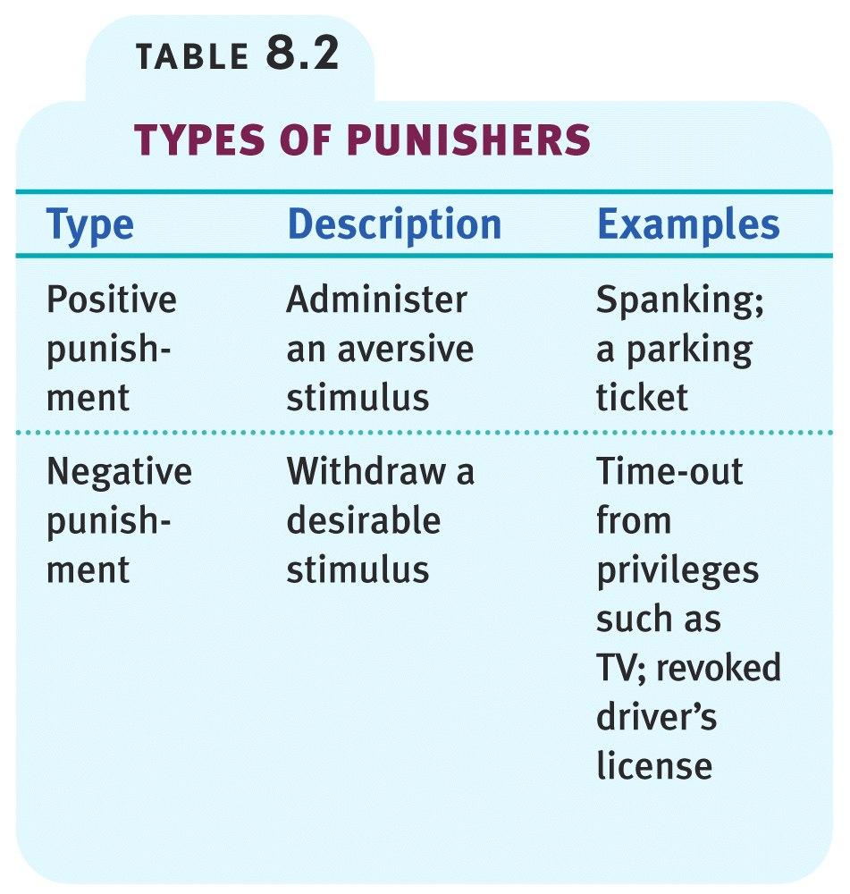
Punishment
Punisher: stimulus/ event which, when its onset is contingent on a response, decreases the likelihood of the response occurring again
Punishment: use of punishers to stop the behaviours /response from occurring in the future

Slide 42
When does punishment work
Intensity
Consistency
Closer the punishment is in time and date to the behavior being punished
Less effective: strong response tendency; adaptation
Efficacy: use mild punishment to suppress one behavior along with positive reinforcement for another behaviour

Slide 43
Significance
Social behaviours
Therapy
Business operations: employee productivity and profits
Programmed learning
Education: personalized system of instruction

Slide 44
Cognitive Learning
Cognition: processing of information about the environment that is received through the senses
Cognitive processing: selection of information; alteration of information, elaboration in thought;, storage of information in memory; retrieval of stored information
Cognitive Map
  mental representation of the layout of one’s environment
Latent Learning
  learning that occurs, but is not apparent until there is an incentive to demonstrate it

Slide 45
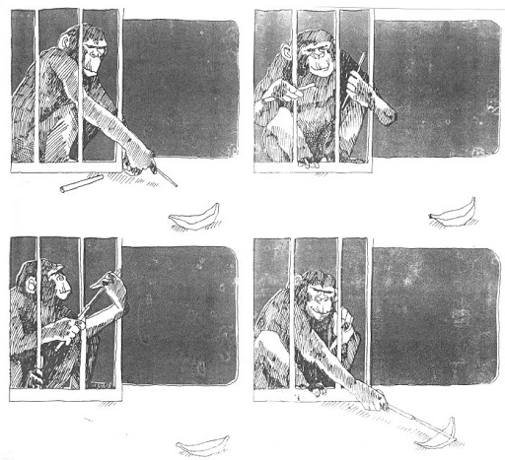
Insight learning: a period following a problem where no progress is made and then the solution suddenly occurs (‘aha moment’)
Imitation: model behavior on that of someone else

Slide 46
Cognition and operant conditioning
Overjustification Effect
  the effect of promising a reward for doing what one already likes to do
  the person may now see the reward, rather than intrinsic interest, as the motivation for performing the task
Intrinsic Motivation
  Desire to perform a behavior for its own sake and to be effective
Extrinsic Motivation
  Desire to perform a behavior due to promised rewards or threats of punishments

Slide 47
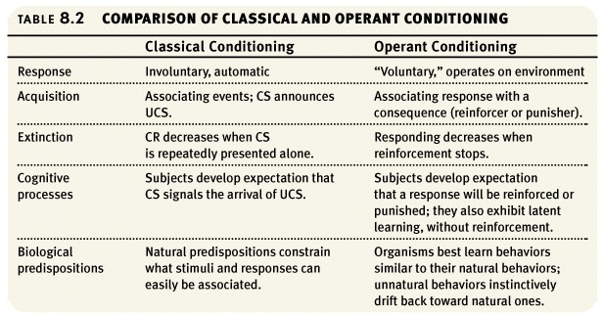

Slide 48
Observational Learning
  learning by observing others
Modeling
  process of observing and imitating a specific behavior
Prosocial Behavior
  positive, constructive, helpful behavior
  opposite of antisocial behavior

Slide 49
Also called: Social Learning Theory
Different take on learning:
We not only learn through direct experience, but also by observing and imitating others (through modeling).
  Not simple, automatic, requires attention & sometimes motivation

Slide 50
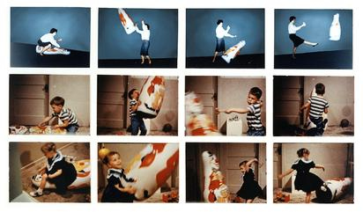
1. Bandura - Bobo Doll Studies.
  Learned how to aggress (modeled behavior).
  Inhibitions were lowered (thought of new ways to aggress).
2. Vicarious Learning: learning by watching others with NO reinforcement.

Slide 51
Influence of TV and media on behavior:
APA’s Conclusion: There is a causal link between watching aggressive acts on TV and being aggressive IN SOME CHILDREN.
TV/Media – not the ONLY cause of aggressive behavior.

Slide 52
The learner and learning
Prepared behaviours and species typical defence reactions
Unprepared behaviours: learned with a moderate amount of difficulty
Contraprepared behaviours: learned with great difficulty if at all learned

